Slide 1
Vision and Offering
Answers why Binary Affairs
Arpan Kar
Thursday, 15 October 2015

Slide 2
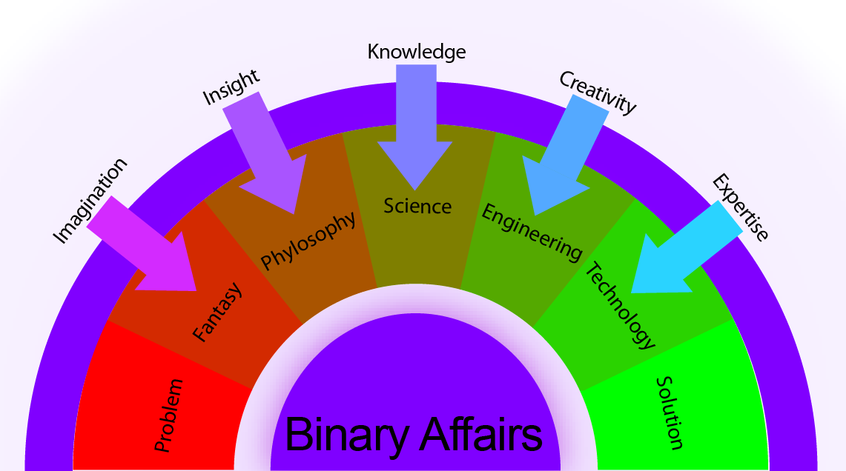
Vision
Every problem has at least one solution. Our vision is to reveal that.
Our vision is to make affair between Problem and Solution.
We are here for unique binary affairs between You and Us.

Slide 3
Offering
Software Product
Consultancy
End to End Service
Infrastructure Service

Slide 4
Software Product
Business Accelerator
Tourism
Education
Health Care
Small Office
Logistics
…
Personal Assistant
CA
Lawyers
Doctor
…
Software products are based on most popular need from market. These Software are typically business accelerators which will help original business to grow faster.

Slide 5
Consultancy
IT opportunity to improve business
Optimizing existing IT solution
Reviewing existing application
Providing architectural solution
Consultancy services will provide solutions to cope with existing problems and will identify new opportunities to boost up business by automating part of the existing system. This service will typically guide IT team of the organization to resolve issues.

Slide 6
End to End Service
Web based solution
Client server solution
Smart device solution
Hybrid solution
End to End Service will develop automated system to solve any business problem. The solution may be internal application or customer facing internet application or modern smart device application.

Slide 7
Infrastructure Service
Networking
Infrastructure Solution
Annual Maintenance
Infrastructure Service will provide hardware support and maintenance service. This may be networking in office for computers or installing web cam for security.

Slide 8
Arpan Kar
(91) 98864 08746
arpan.kar@binaryaffairs.com

